Slide 1
Level attraction in metamaterials simulation results
Yutong Zhao
Feb 11th 2019

Slide 2
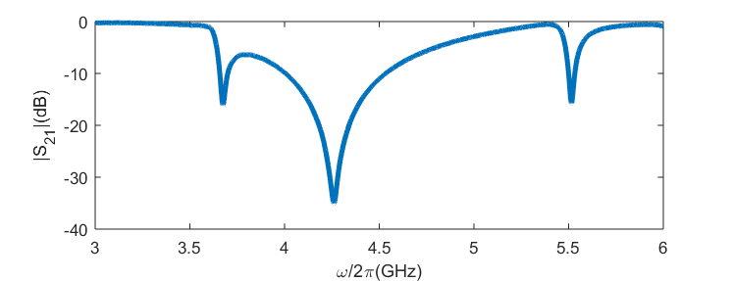
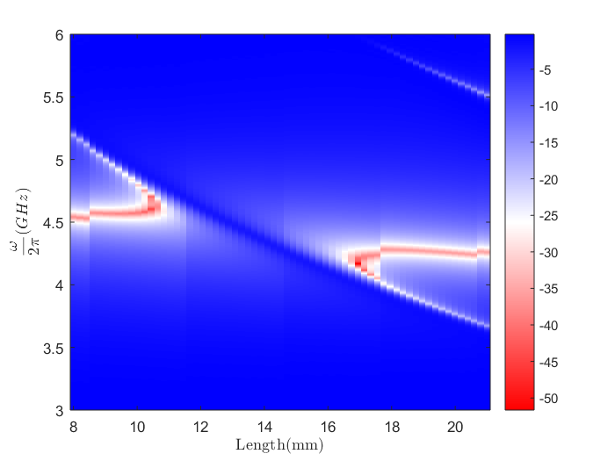
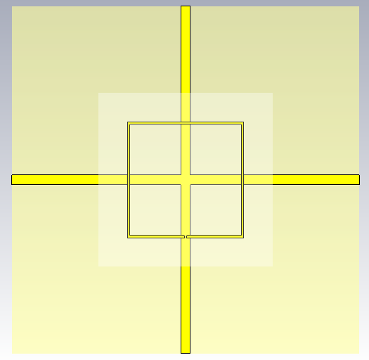
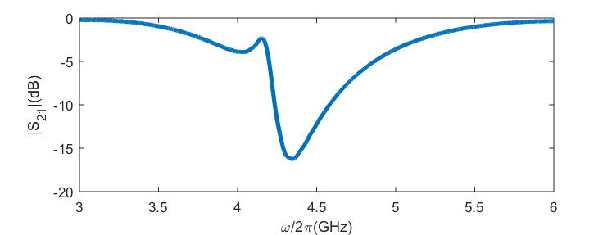
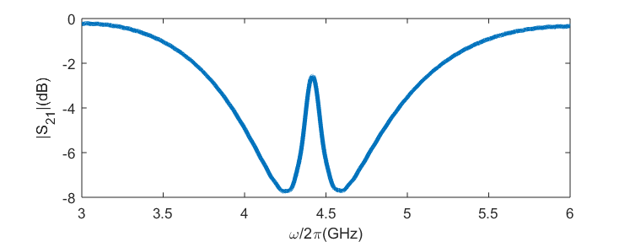
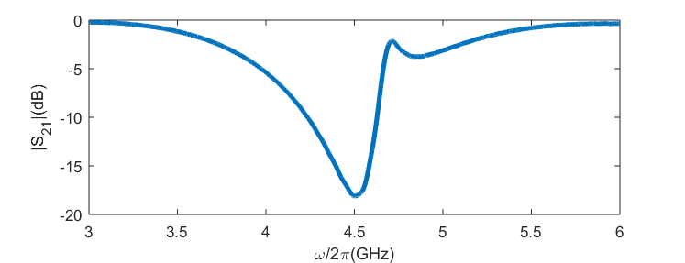
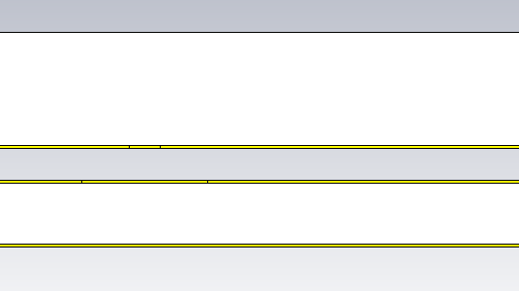
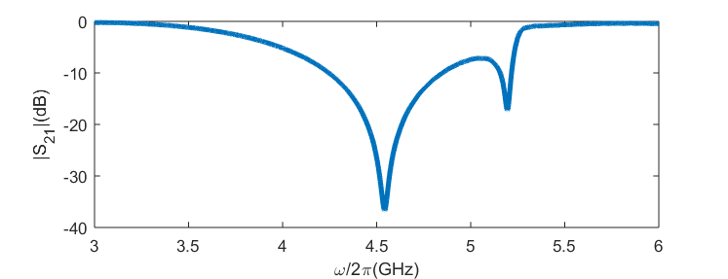
spectra
Set up
CST simulation
V
open
S21
IV
port1
port2
L
gap
III
open
L
II
SSR is 0.2 mm above the board
I
II
III
IV
V
SSR
I
0.2mm
Cross cavity

Slide 3
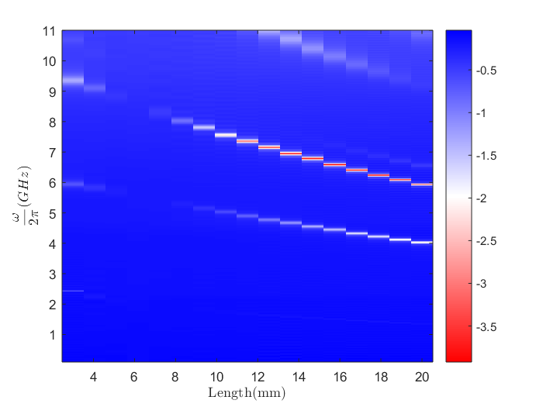
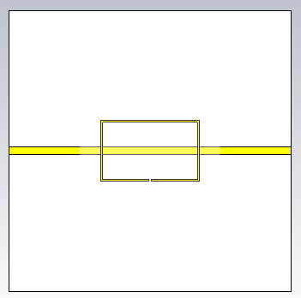
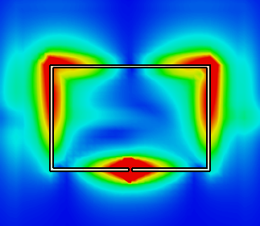
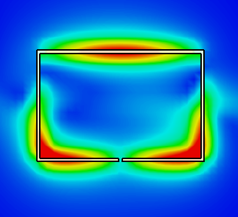
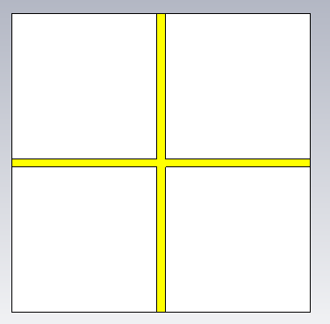
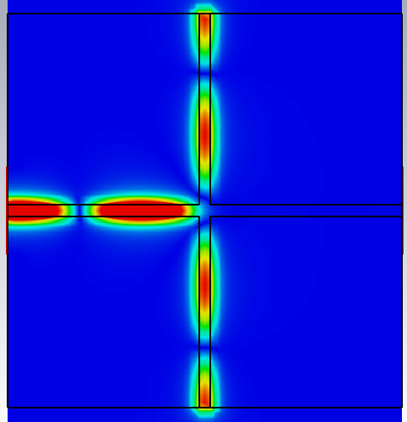
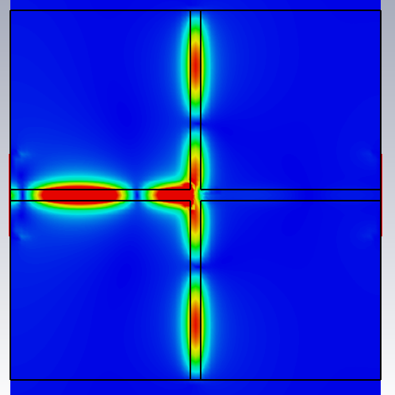
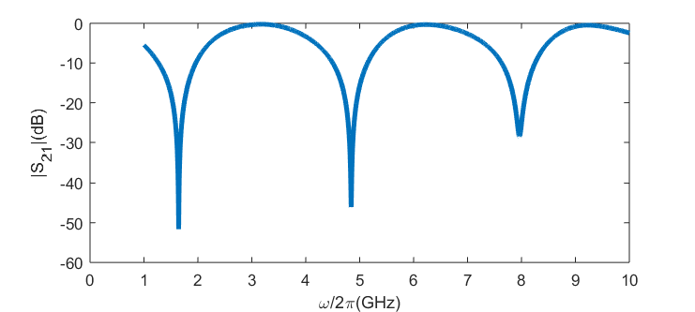
Distributions
S21
Characterize SSR
E field
H field
Characterize cross cavity
E field
H field
S21

Slide 4
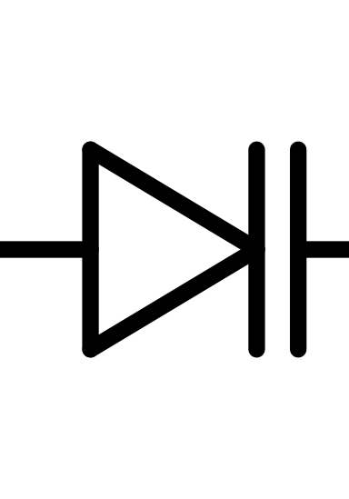
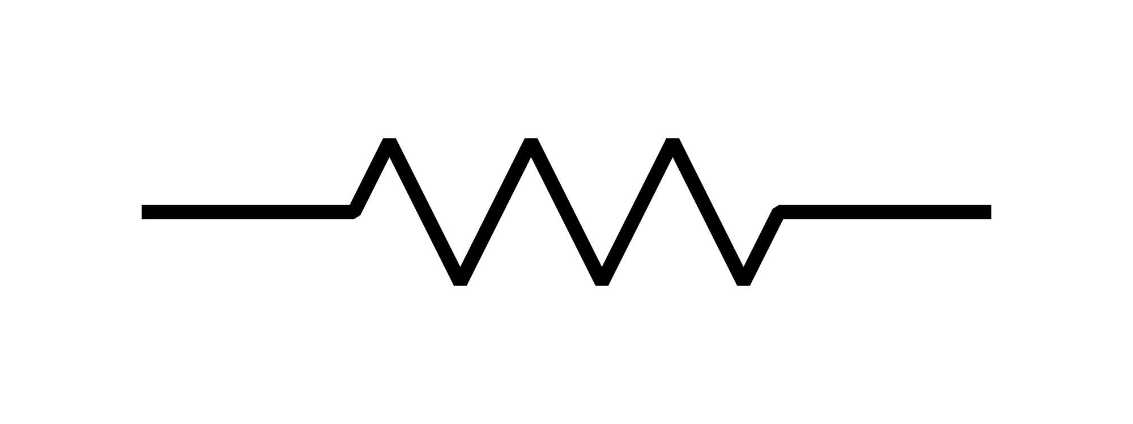
Experiment design:
Using a varactor diode can brings the ability changing the resonance of the SRR. → (~600MHz)
Changing the resistance on SRR is easier than YIG sphere. → tunable damping
Objective:
Realizing the microwave circuit of the level attraction.
Gives the possible approach to explore the exceptional point of level attraction.

Slide 5
